Slide 1
Shaken Baby Syndrome Prevention
Training provided by Child Abuse Prevention Council of Sacramento

Slide 2
Workshop Goals
Define Shaken Baby Syndrome (SBS)
Identify the signs and symptoms of SBS
Explore common triggers to shaking a baby
Teach parents how to formulate a plan for handling frustration, anger, and stress when a baby cries
Identify resources for SBS prevention
Raise awareness on parental experience

Slide 3
Shaken Baby Syndrome is…
Clinical Definition: Shake Baby Syndrome, or SBS, is a form of Abusive Head Trauma (AHT) that causes bleeding over the surface of the brain, swelling of the brain, bleeding at the back of the eyes, and other injuries not seen together in any other disease or medical condition.
Layperson’s Definition: Child abuse involving the shaking of a baby.

Slide 4
What happens during SHAKING…

Slide 5
Why is a baby so vulnerable?
Heavy head - 25% of body weight
Weak neck muscles - Can’t resist movement
Space inside skull - Force increases
Delicate veins - Tear and bleed easily
Brain is still developing - Vulnerable to injury

Slide 6
Immediate Signs and Symptoms of Severe Shaking
Absence of response to stimulation
Lethargy
Convulsions
Inability to make sounds
Inability to track movement visually
Difficulty breathing
Blue-looking or dusty skin tone
Unconsciousness
Vomiting
Crying quieted to whimpering due to brain damage
Rolling eyes

Slide 7
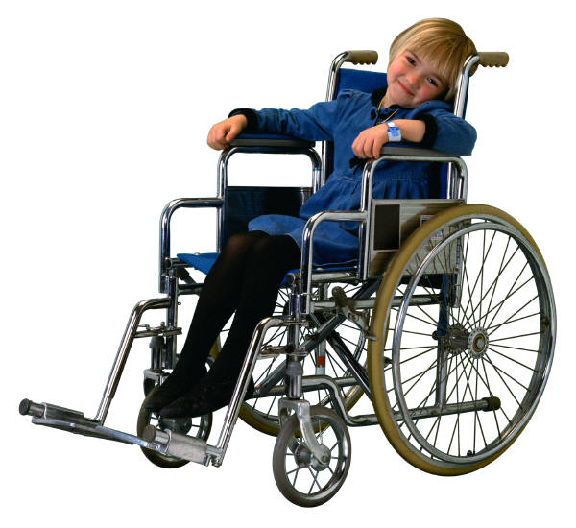
Long Term Effects
Learning and cognitive disabilities
Behavioral disorders
Blindness
Paralysis on one or both sides
Trauma-induced seizure disorders
Loss of motor control
Death

Slide 8
Sacramento County Statistics
In 2009, 5 Sacramento babies were hospitalized for SBS or abusive head injuries. (~10 % of California cases)
1 one year old & 1 two year old were treated and released or transferred to a different hospital
In 2010, 6 Sacramento babies were hospitalized for SBS or abusive head injuries. (~9 % of California cases)
On average, 1-2 cases per year of SBS fatalities are not counted in hospital data because the infant died at the scene.

Slide 9
Prevention Works
SBS is preventable WITH EDUCATION.
When parents and caregivers know . . .
the injuries that shaking causes
and
ways to manage their frustration and stress
. . . they will STOP before they SHAKE.

Slide 10
Sacramento County’s SBS Prevention Program
Strength-Based Approach & Universal in application involving:
8 birthing hospitals in Sacramento who are committed to prevention
Involves local home visitation programs in Sacramento
Before discharged from the hospital…
Parents are shown a brief training DVD (Portrait of Promise) that provides education on SBS and demonstrates effective ways to respond to an infant’s crying.
A hospital health educator reviews the key components of SBS and infant crying with the parents and gives them a “Babies Cry” door hanger.
Parents then sign a “commitment statement” never to shake their baby and to pass this mandate on to all other adults that will care for their baby.
Notes:
*SHOW PORTRAIT OF PROMISE*

Slide 12
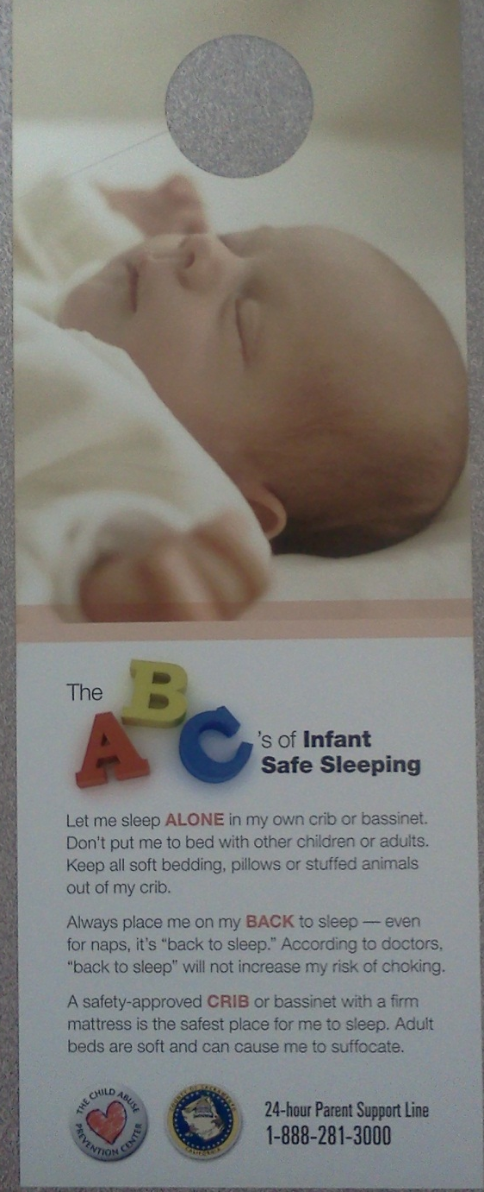
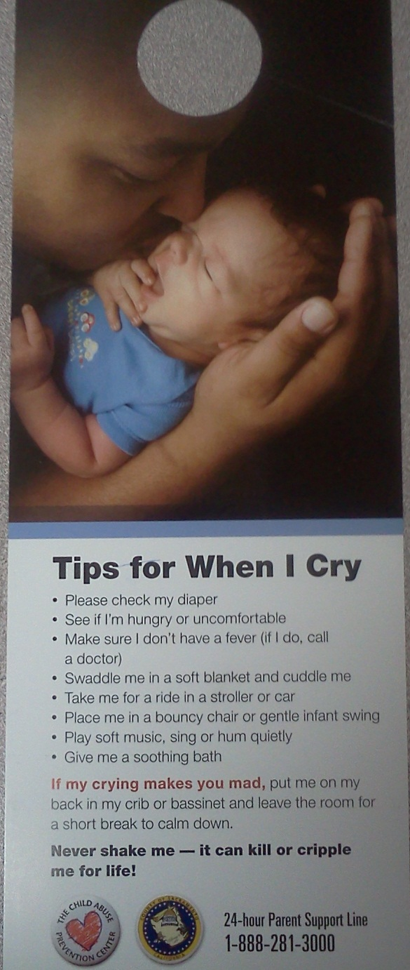

Slide 13
Portrait of Promise

Slide 14
What trigger’s SHAKING?
#1 Caregiver could not stop a baby from crying
Frustration builds
Caregiver does NOT take care of himself or herself
Caregiver loses control
Caregiver shakes the baby

Slide 15
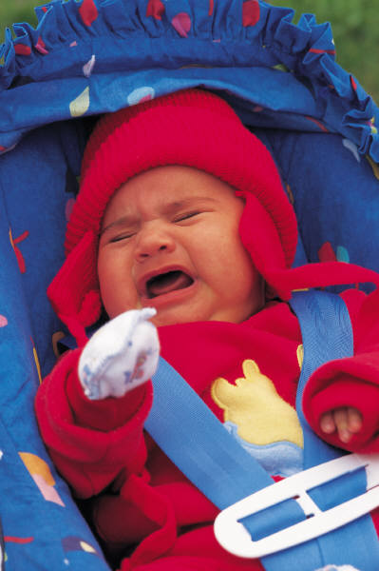
Why do babies CRY?
A baby may cry because he or she . . .
Is hungry
Needs to burp or is gassy
Wants to suck (on a pacifier or a clean finger)
Needs a diaper change
Is too hot or too cold
Is getting sick/has a fever
Has diaper rash
Is teething
Is tired
Is over-stimulated

Slide 16
Check Basic Needs
Does the baby’s diaper need changing?
Is the baby hungry?
Is the baby being scratched or poked by something?
Does the baby want to be cuddled?
Does the baby want to be played with?
Or . . .
Is the baby too hot? Too cold?
Is the baby overtired?
Is the baby teething?
Is the baby bored?
If not, then . . .

Slide 17
Ways to sooth a crying baby
Please check the baby’s diaper
See if the baby is hungry or needs to be burped
Make sure the baby doesn’t have a fever (if there is a fever, contact a doctor)
Swaddle the baby in a soft blanket and cuddle the baby
Take the baby for a ride in a stroller or car
Place the baby in a bouncy chair or gentle infant swing
Play soft music, sing or hum quietly
Give the baby a soothing bath

Slide 18
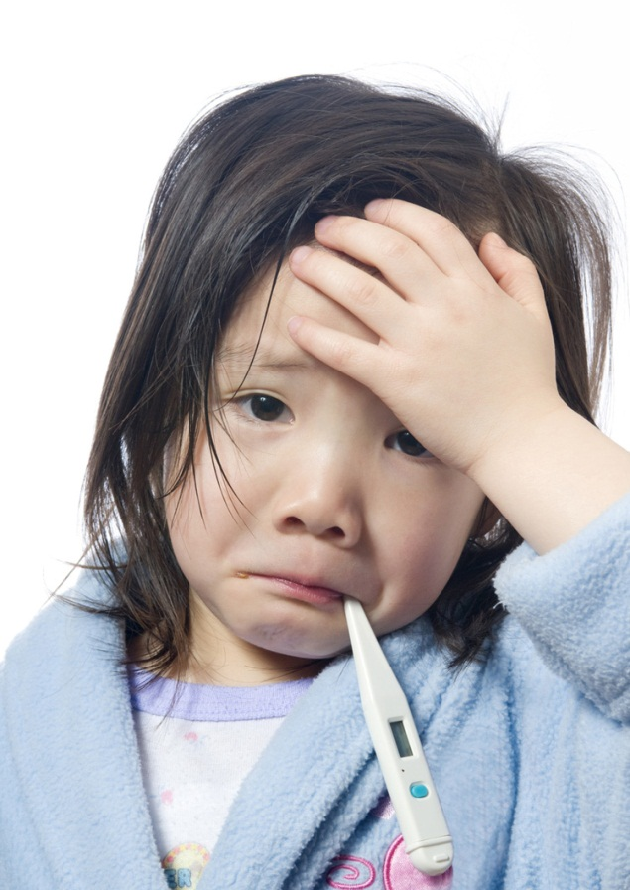
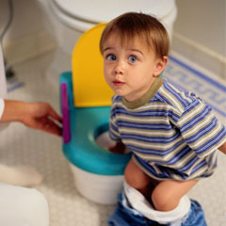
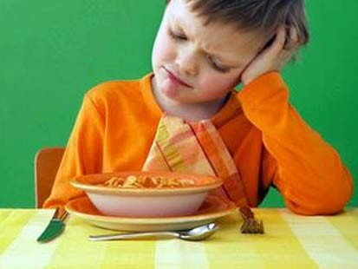
Secondary Triggers for SHAKING

Slide 19
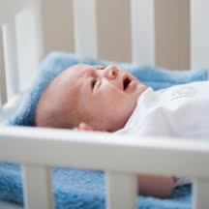
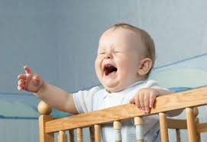
Have a Safety Plan
What is the Safety Plan or Safety net?
Is there a plan to put the baby somewhere safe when the family member or caregiver becomes frustrated?

Slide 20
Coping Skills
Ensure the parents you are working with are constantly practicing & engaging in…
Stress Management
Anger Management
Positive Discipline
Ages and Stages of Children
Nurturing and Empathy
Overall Parenting Skills

Slide 21
Healthy Responses
Put the baby on its back in a crib or room safely and leave the room
Take a 10 minute break to calm down
Contact a family member or friend to vent/talk
Listen to soothing music
Exercise (dance, sit ups, push ups, jumping jacks, yoga, and deep breathing -your baby might like to watch!)
Remind yourself THE CRYING WILL END
If you need help, call the Parent Support Line at:
1-888-281-3000 (24 hours a day/7 days a week) or call 911

Slide 22
REMEMBER:
No baby has died from crying too much.
If someone calls you frustrated with a
crying baby, offer your help. Provide an open ear & a resource.
NEVER SHAKE a BABY!
If you need help, call the
Parent Support Line
1-888-281-3000 or 911
Sacramento County Information & Referral Line:
(916) 244-1906

Slide 23
Guest Speaker – parental experience
Help me welcome Scott Juceam

Slide 24
QUESTIONS????

Slide 25
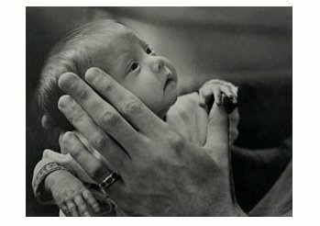
Thank You for Participating
Please complete a:
Learning Assessment

